Slide 1
Structured Mesh Generation

Slide 2






Summer Research Internship Presentation
Presented By:
Rahul Sawlani
EEE
181230039
Supervised By:
Dr. Ravi Kumar Arya
ECE

Slide 3
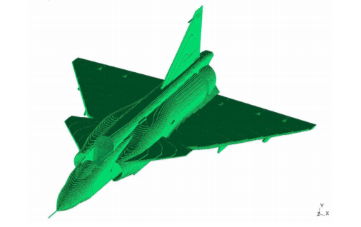
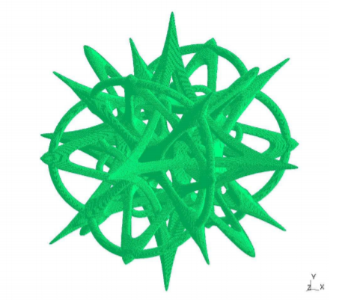
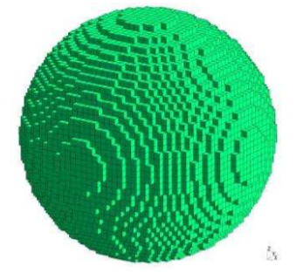
What Is Structured Mesh?
Structured Mesh is the representation of arbitrary model geometry in the form of regular cuboidal elements as depicted in the pictures.
These cuboidal elements are called Yee-Cells and are the fundamental elements of most Finite-Difference-Time-Domain(FDTD) methods.

Slide 4
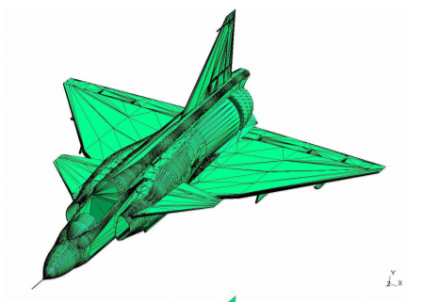
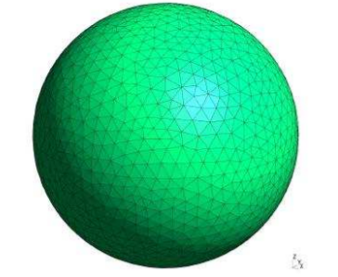
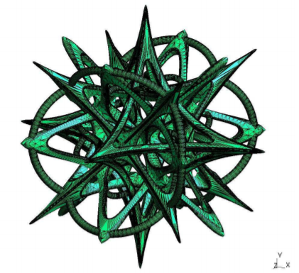
Unstructured Triangular Mesh
The representation of 3D figures/geometries in the form of irregular grid of triangles on the surface.
These are irregularly connected.
The mesh generator takes Unstructured Triangular Mesh as input.

Slide 5
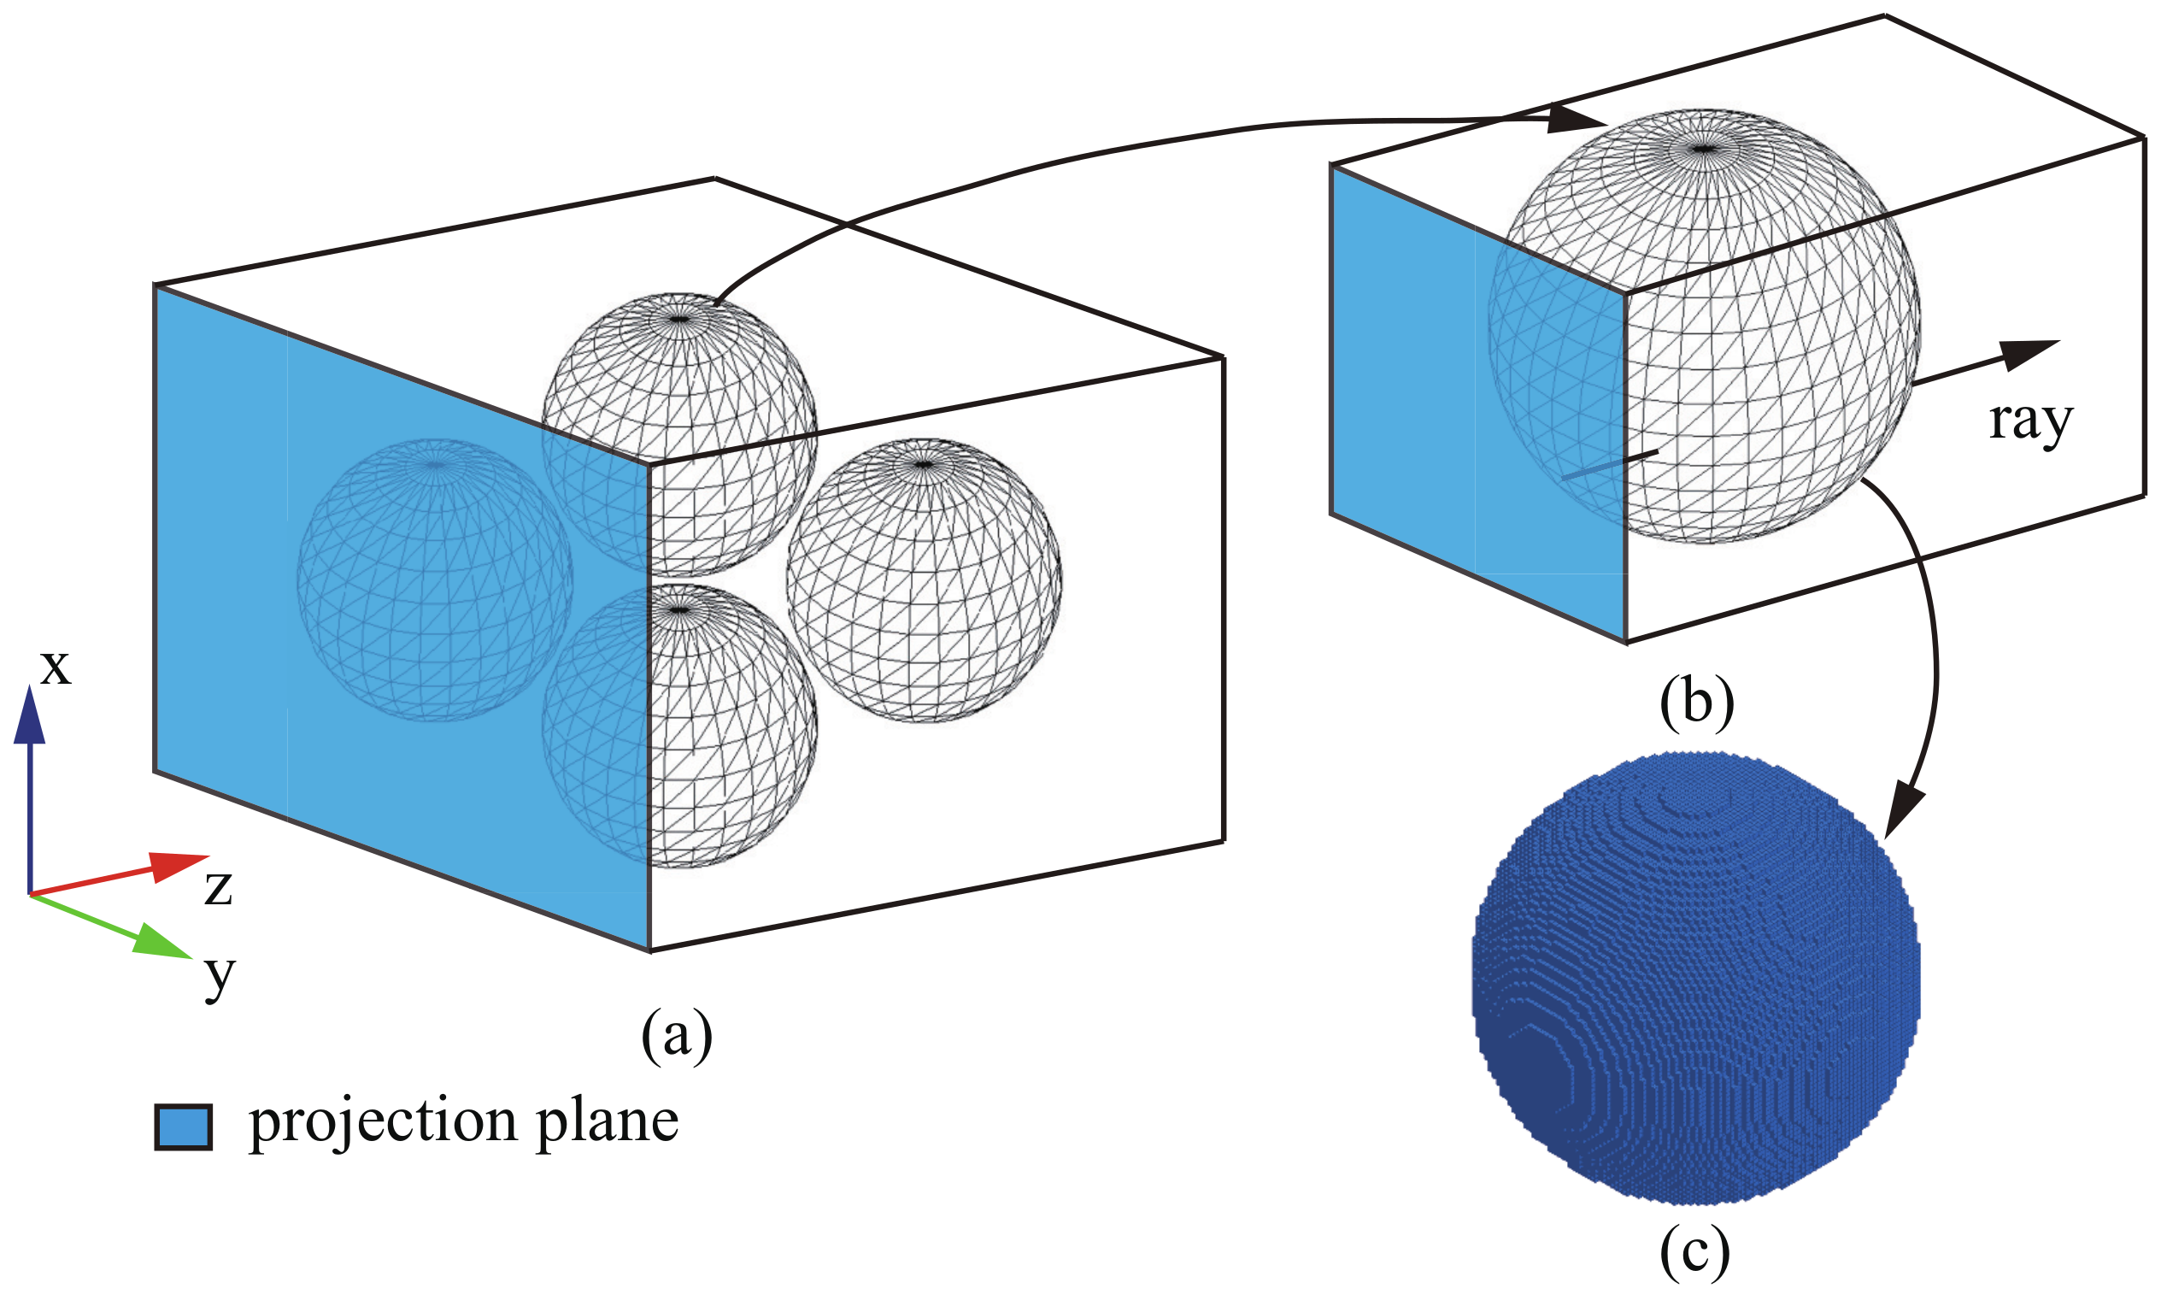
3
The Step Process
Read the Input Geometry
Use Ray-Casting Triangle Intersection Method
Generation of Output Structured Mesh

Slide 6
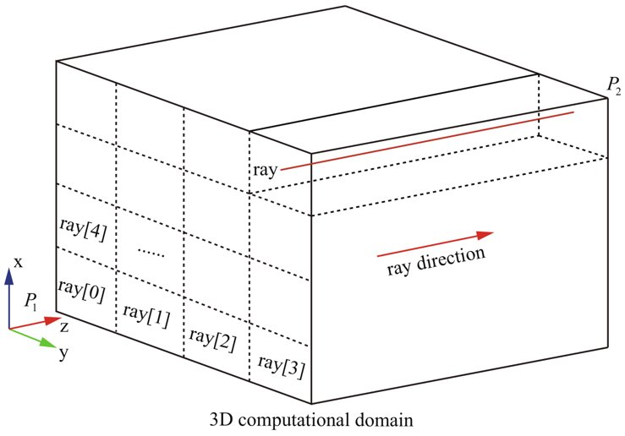
Our Way for Ray Casting
We take an input grid of rays in X-Y plane and cast it in the Z direction as shown in figure.
The surface of object with triangles intersects with the rays and give intersection points.
We generate cubical elements at the intersecting points and in the volume of geometry.

Slide 7
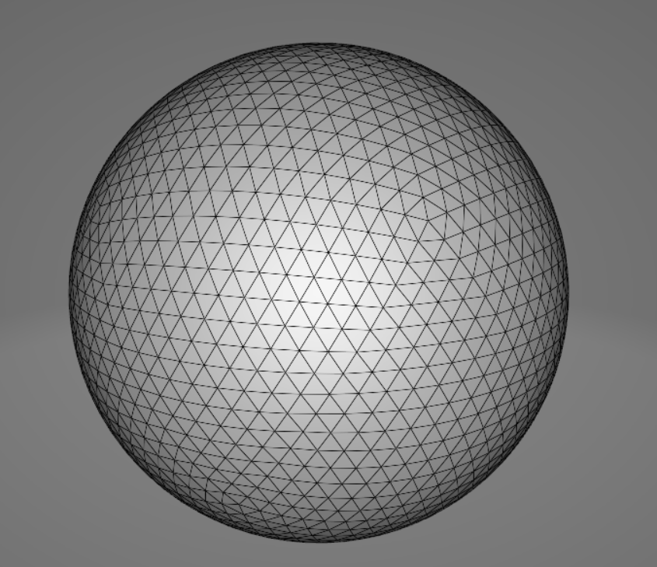
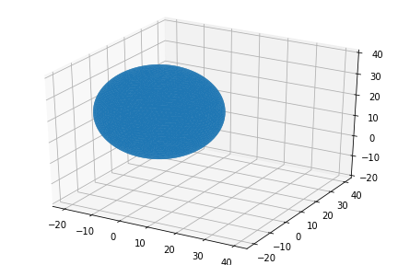
Our Geometry
Sphere

Slide 8
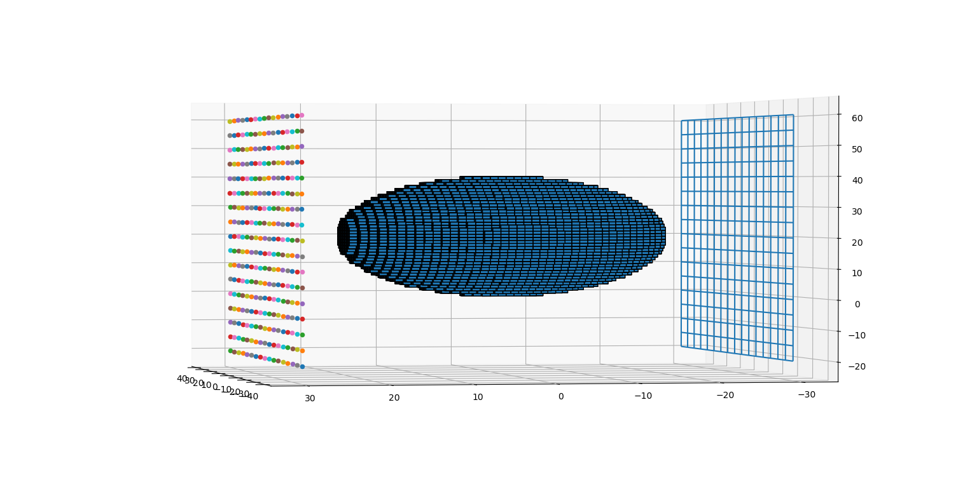
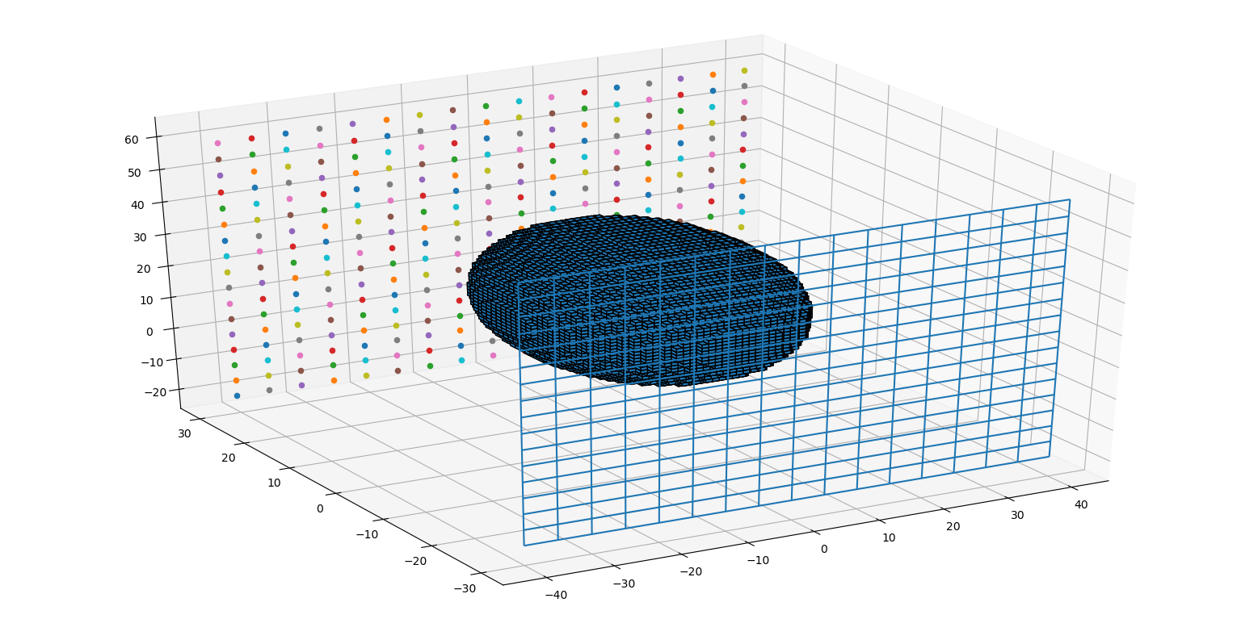
Output Structured Mesh
End Points of Rays
Input Grid of Rays

Slide 9
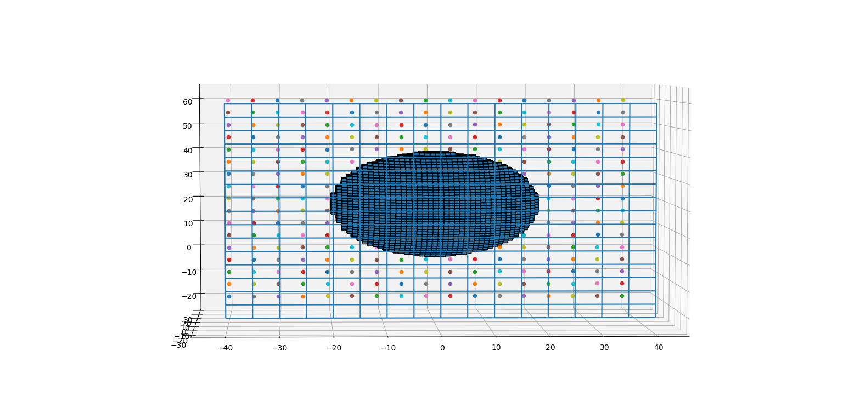
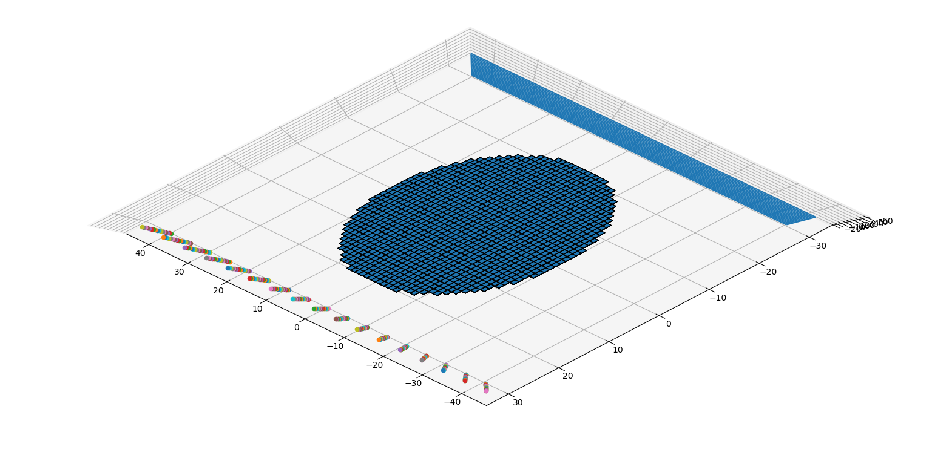
More Views
Voxels
Top View

Slide 10

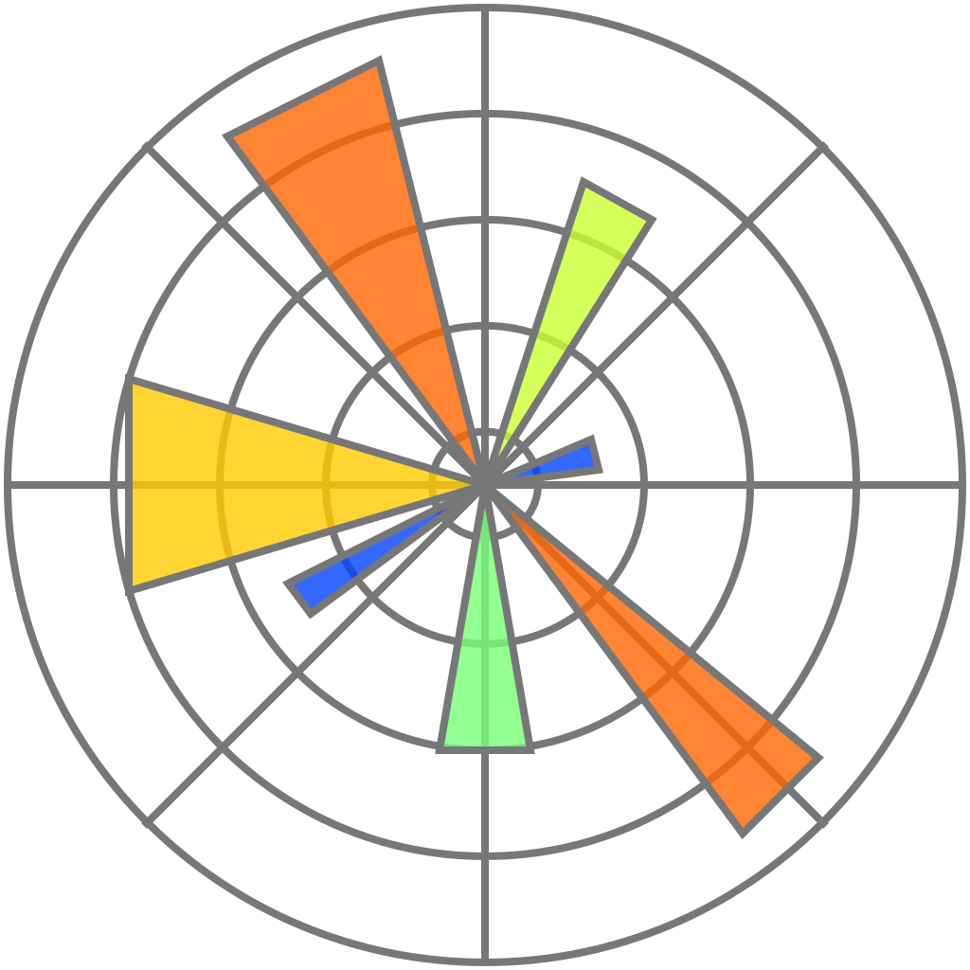
Tools Used
Language: Python Version 3.6.8
Text Editor: Python IDLE
Libraries: numpy(numerical calculation), matplotlib(ploting graphs), mpl_toolkits(ploting 3D figures), stl(processing 3D figures in stl format), itertools(slicing and iterting triangle vertices)
Operating System: Windows 10
Processor: Intel Core i5-8300H CPU @ 2.30 GHz

Slide 11
Why and Where it is used
The finite-difference time-domain (FDTD) method is a numerical technique that is widely used to solve Maxwell’s differential equations in the time domain.
Although there are many freely available computer-aided design (CAD) or meshing programs that can directly create an unstructured polygonal mesh there are no freely available meshers that create structured cuboid meshes with sufficient generality for practical EM simulations of complex structures.
Therefore we have developed a Python code for uniform and non-uniform structured mesh generation.
Moreover, the code can be used as a tool to aid the understanding of mesh generation, and for experimentation with mesh generation techniques.

Slide 12
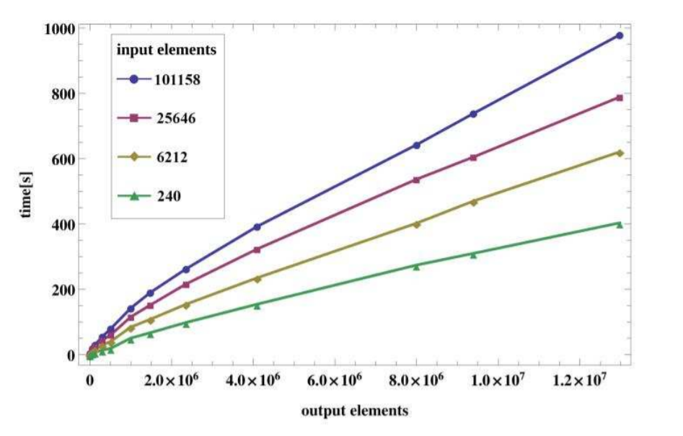
Optimization
The number of unstructured input elements and structured output elements both have a significant influence on the performance. The number of output elements includes both the cells for the both the objects themselves and the free space in the computational volume.
The resulted output is generated using Windows 10 PC with Intel Core i5 8300H CPU running at 2.30GHz.
Figure shows how the CPU-time increases with the number of output elements.
The parallelization of the algorithm with regard to casting different rays on separate computational cores with the help of GPU has not been fully implemented. This will substantially improve the performance on large models.

Slide 13
Conclusion
This presentation presents an open-source implementation of an algorithm for uniform and nonuniform cuboid mesh generation for FDTD solvers and similar codes.
The mesher takes an unstructured mesh as input, thus allowing great flexibility in the CAD tools that can be utilized in the initial creation of the simulation geometry.

Slide 14
References
Michael K. Berens, Ian D. Flintoft, John F. Dawson Open Source Automatic Non-uniform Mesh Generation for FDTD Simulation Jan 2016, IEEE Antennas and Propagation
T. Moller and B. Trumbore, Fast, minimum storage ray/triangle intersection, ACM SIGGRAPH 2005 Courses, USA: Los Angeles, 2005
Representation of voxels using matplotlib available: https://www.semicolonworld.com/question/60040/representing-voxels-with-matplotlib accessed on July30, 2020
A Three-Dimensional Cartesian Mesh Generation Algorithm Based on the GPU Parallel Ray Casting Method available : https://www.mdpi.com/2076-3417/10/1/58/htm accessed on
July 30, 2020

Slide 15
Thank You!

